Slide 1
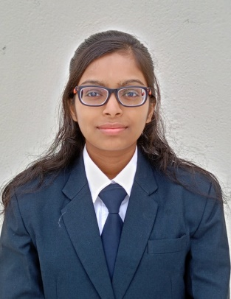
INTERNSHIP TRAINING FULFILMENT SHEET
Instruction:
Please fill the table accordingly and send back the digital copy in the same .ppt format.
Do not change/modify anything
Paste Passport Photo Within The Box
Name | DRAKSHA
Branch | COMPUTER SCIENCE ENGINEERING
Pursuing Semester | 7th Semester
Institution Name | University of Engineering and Managemant, Kolkata
Contact No | 9263721108
Address | KL 1/3, near ghari park Telco,, JAMSHEDPUR
Name Of Project | Vehicle Servicing and Maintainance Chatbot
Mentor Details | SANKET MOHANTY (PROJECT MANAGER)
Internship Start Date | 19/06/2024
Internship End Date | 19/07/2024
Skills Learned | LLM(fine tuning)
E-Mail ID | draksha138@gmail.com

